Slide 1
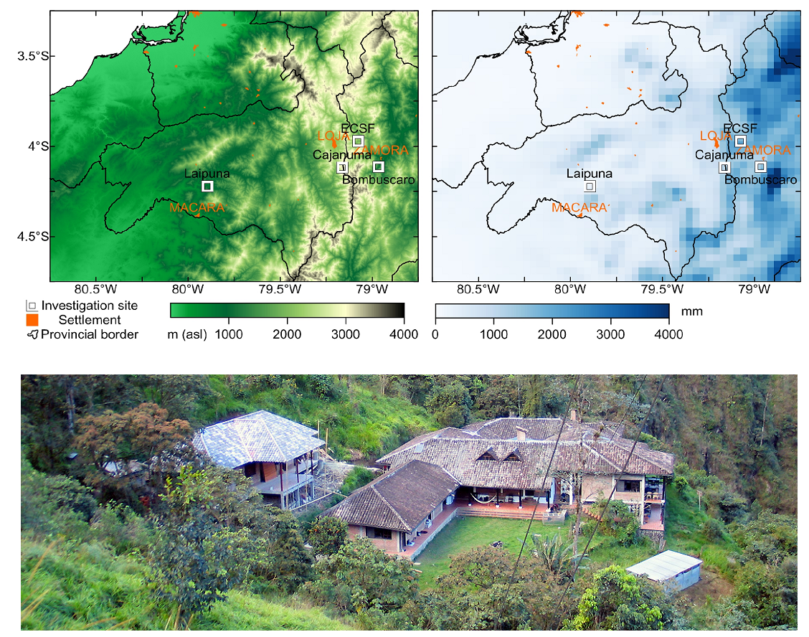
Chapter 1: iWUE variation between
NUMEX experiment manipulation
Ho: Expected iWUE increase in N plots.
RQ:
What is the effect of fertilization on iWUE and other physiological traits?.
What are the trends between elevation?

Slide 2
RQ:
What are the differences in the ecophysiological responses between treatments? Effect of elevation?
Ho:
Nutrients will have an effect on ecophysiological responses.
- Increase of WUE by enhacement of photosynthesis.
- Increase of water transpiration with N → more enrichment of dO18.
- Interaction of nutrients N*P will posible lead to increase/decreases of iWUE.

Slide 3
Site | Elevation (m.s.n.m) | N° Plots | Individuals per plot | Status
Cajanuma | 3000 | 16 2024 | Between 7-10 per experimental group Pouteria torta Clarisia racemosa | SLA, thickness, punch resistance, C:N, 15N, 13C, 18O, nutrients – pack to send Jürgen
San Francisco | 2000 | 16 2023 | Between 10 per experimental group Myrcia y Alchornea | C:N, 15N, 13C, 18º, dry matter, Missing leaf areas and SLA
Bombuscaro | 1000 | 16 2024 | Between 7-10 per experimental group Weinmania = Hedyosmum purpurascens = | SLA, thickness, punch resistance, dry matter, C:N, 15N, 13C, 18O, nutrients – pack to send Jürgen
I processed samples from 2009 too, but only the controls.
Notes:
Data collected and processed in green. In red, the missing data.

Slide 4
Summary of the response variables analyzed to the date
 |  | n | δ15N (‰ v.s.AIR) |  | δ18O in ‰ vs DeltaSMOW |  | δ13C (‰ v.s.V-PDB) |  | iWUE (μmol/mol) |  | C:N
 |  |  | mean | std | mean | std | mean | std | mean | std | mean | std
Alchornea lojaensis | C | 12 | -5.27 | 1.16 | 29.67 | 1.02 | -26.51 | 0.89 | 93.16 | 10.84 | 43.02 | 6.87
 | N | 10 | -2.57 | 1.57 | 29.74 | 1.14 | -26.57 | 1.13 | 92.47 | 13.88 | 37.7 | 4.76
 | NP | 8 | -2.44 | 0.69 | 29.51 | 1.12 | -26.77 | 1.45 | 90 | 17.73 | 40.44 | 4.32
 | P | 15 | -5.08 | 0.96 | 29.54 | 1.57 | -27.06 | 1.51 | 86.5 | 18.45 | 44.34 | 5.43
Clarisia racemosa | C | 3 | 0.61 | 0.82 | 26.51 | 0.53 | -30.63 | 0.42 | 42.6 | 5.21 | 24.51 | 2.92
 | N | 1 | 0.47 |  | 31.23 |  | -31.8 |  | 28.14 |  | 22.29
 | NP | 4 | 2.04 | 0.62 | 30.74 | 2.31 | -30.88 | 0.36 | 39.57 | 4.45 | 18.28 | 1.73
 | P | 4 | 0.6 | 0.51 | 29.77 | 2.73 | -29.84 | 1.24 | 52.29 | 15.26 | 22.65 | 3.13
Hedyosmun purpurascens | C | 5 | -2.58 | 2.62 | 26.34 | 0.71 | -26.81 | 1.44 | 89.58 | 17.68 | 30.78 | 2.77
 | N | 6 | -1.13 | 1.59 | 27.66 | 1.99 | -26.35 | 2.06 | 95.09 | 25.19 | 25.77 | 5.26
 | NP | 3 | -0.77 | 0.64 | 26.68 | 1.48 | -24.85 | 1.27 | 113.48 | 15.43 | 26.1 | 2.81
 | P | 7 | -1.42 | 1.6 | 27.25 | 1.31 | -27.29 | 1.59 | 83.66 | 19.44 | 28.12 | 2.51
Myrcia sp nov | C | 15 | -3.58 | 1.98 | 30.63 | 0.52 | -27.79 | 1.15 | 77.47 | 14.13 | 51.73 | 11.71
 | N | 10 | -2.79 | 0.43 | 31.75 | 1.73 | -27.24 | 0.92 | 84.24 | 11.28 | 47.43 | 4.13
 | NP | 13 | -1.64 | 0.76 | 30.97 | 0.94 | -27.27 | 1 | 83.88 | 12.23 | 47.79 | 4.16
 | P | 12 | -4.48 | 0.91 | 30.44 | 0.95 | -27.34 | 0.66 | 83.09 | 8.12 | 58.04 | 6.25
Pouteria torta | C | 11 | 1.28 | 0.85 | 30.32 | 1.47 | -31.55 | 0.76 | 31.19 | 9.39 | 31.55 | 2.43
 | N | 10 | 1.49 | 1.06 | 29.32 | 1.39 | -30.37 | 1.83 | 45.8 | 22.53 | 30.55 | 2.74
 | NP | 7 | 1.79 | 0.92 | 28.45 | 1.16 | -31.74 | 1.35 | 28.92 | 16.66 | 29.27 | 1.73
 | P | 8 | 1.01 | 0.76 | 28.93 | 1.24 | -31.27 | 0.93 | 34.72 | 11.53 | 28.9 | 2.18
Weinmania loxensis | C | 5 | -4.45 | 2.16 | 26.56 | 1.65 | -27.7 | 0.27 | 78.64 | 3.3 | 43.15 | 5.79
 | N | 5 | -3.05 | 0.59 | 26.46 | 0.77 | -28.06 | 0.9 | 74.27 | 11 | 39.49 | 5.23
 | NP | 2 | -4.53 | 1.52 | 25.62 | 0.75 | -29.03 | 0.79 | 62.3 | 9.74 | 41.18 | 0.31
 | P | 6 | -5.05 | 1.96 | 26.12 | 0.88 | -28.38 | 1.13 | 70.28 | 13.86 | 41.73 | 5.19

Slide 5
ANALYSIS PER SPECIE
I ran ANOVA interaction tests per species – not showed- but decided to go with glmm for their statistic power.
Per each specie a lmer(Response variable~ N * P + (1 | Block/Plot)) model was conducted.
I used DHARMa package for diagnosis interpretation but I need to know when it is okay to dismiss some trends in the residuals.
See attached: DHARMa diagnostics and Normal Qqplots in the Markdown documents. I would like some help here.
Likewise, how to interpret the estimate of the interactions.

Slide 6
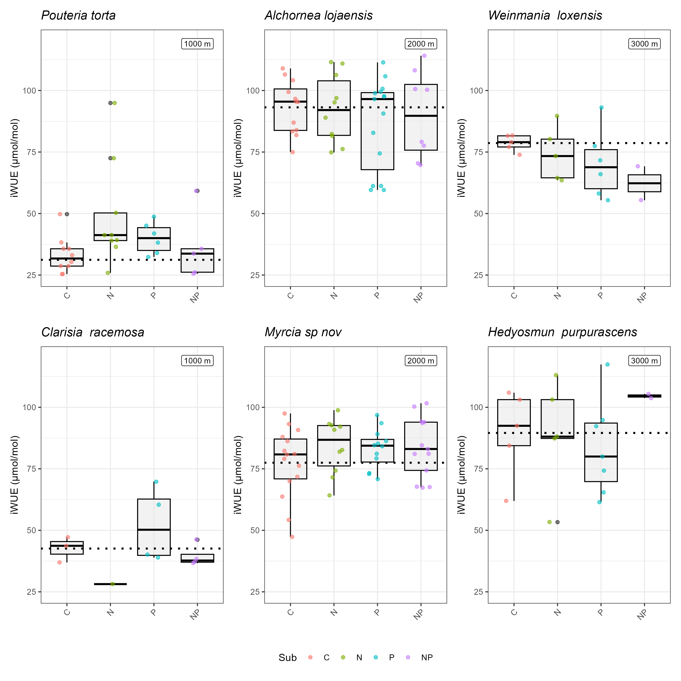
Notes:
The dotted line is the mean of the control.
Weinmania looks that NP has an strong effect on iWUE, but it is not statistical significant.
What I see: With N the iWUE increases, with P iWUE increases as well but less strongly. The interaction has a positive effect on some species (Puteria, Myrcia, Hedyosmum) and negative (less tan control on others (Alchornea, Weinmania).

Slide 7
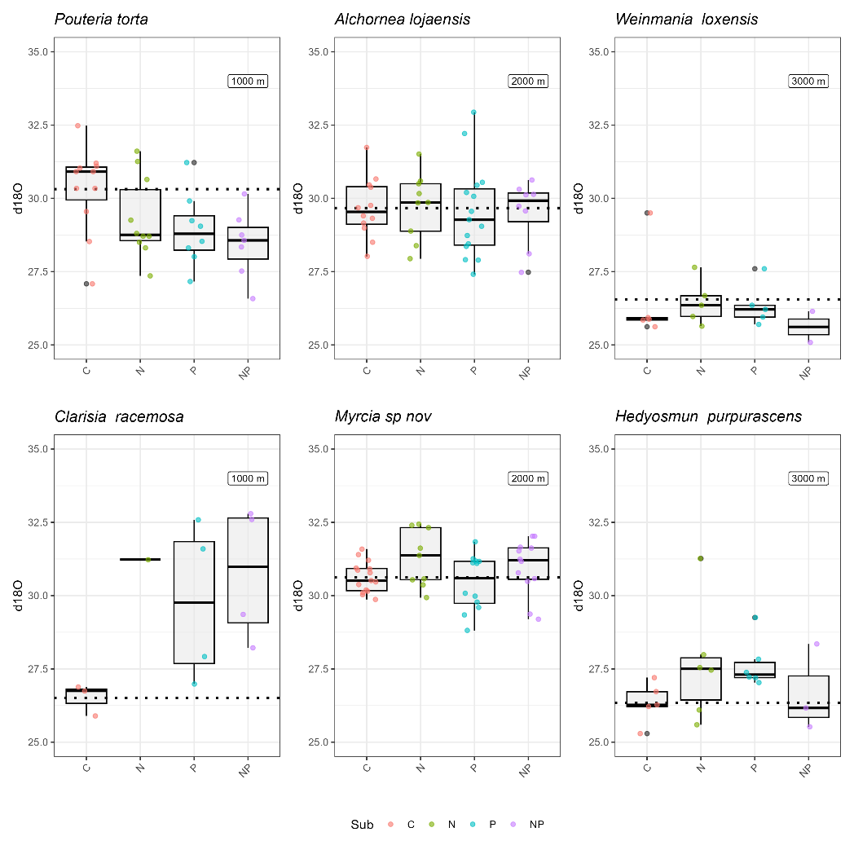
Notes:
The dotted line is the mean of the control.
Pouteria and Clarisia are species at the same elevation with contrasting responses. Clarisia’s enrichment of d18O increases with the N*P.
Only Pouteria and Myrcia showed statistical differences for d18O when adding nutrients.

Slide 8
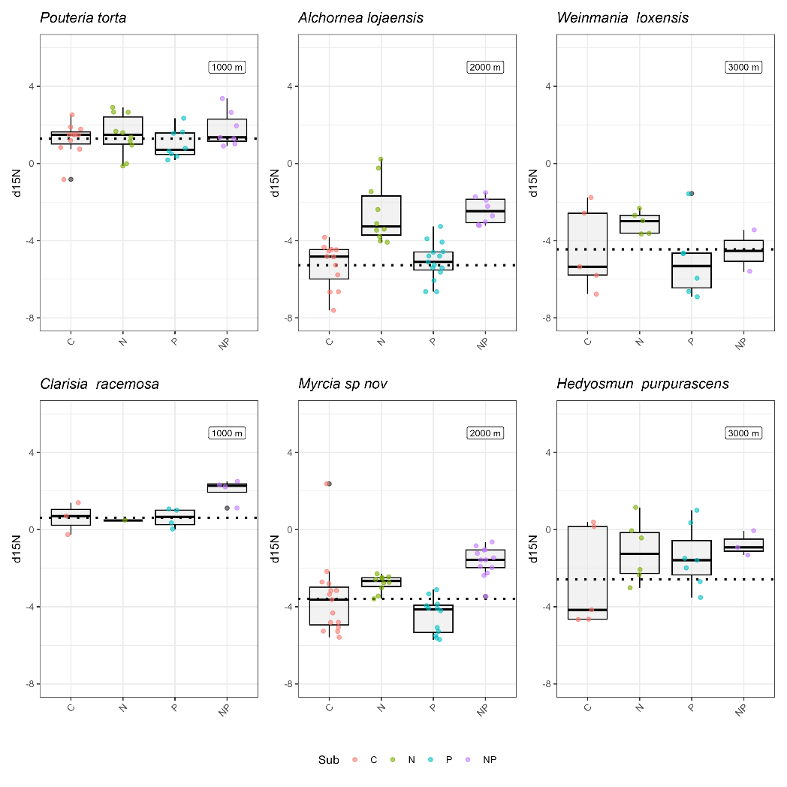
Notes:
None of them are nitrogen fixing species.
How to interpret this one better.

Slide 9
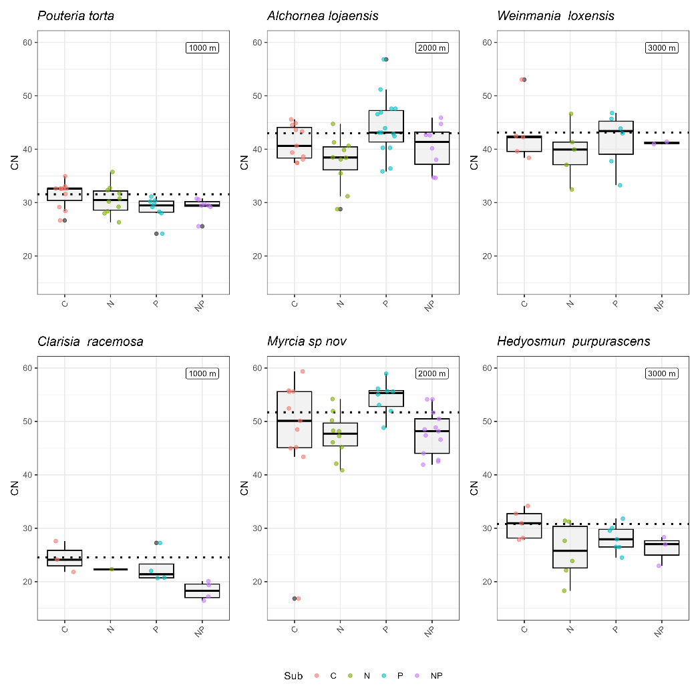

Slide 10
Per specie
lmer(Response variable~ N * P + (1 | Block/Plot))
Notes:
Pouteria torta, effect of the N and N*P on iWUE, and effect of P o d18O. This is the only specie giving a statistical signal response to nutrient addition on iQUE.
Alchornea, effect of the N on d15N and C:N.
Myrcia, effect of N on d18O, d15N, C:N
Hedyosmum, effect of d15N and C:N. (+ p <0.1)

Slide 11
ANALYSIS PER EACH ELEVATION
Per each elevation, I ran a
lmer(Response variable~ N+P+N * P + (1 | specie)+ (1 | Block/Plot)).
Again, I used DHARMa package for diagnosis interpretation but I need to know when it is okay to dismiss some trends in the residual

Slide 12
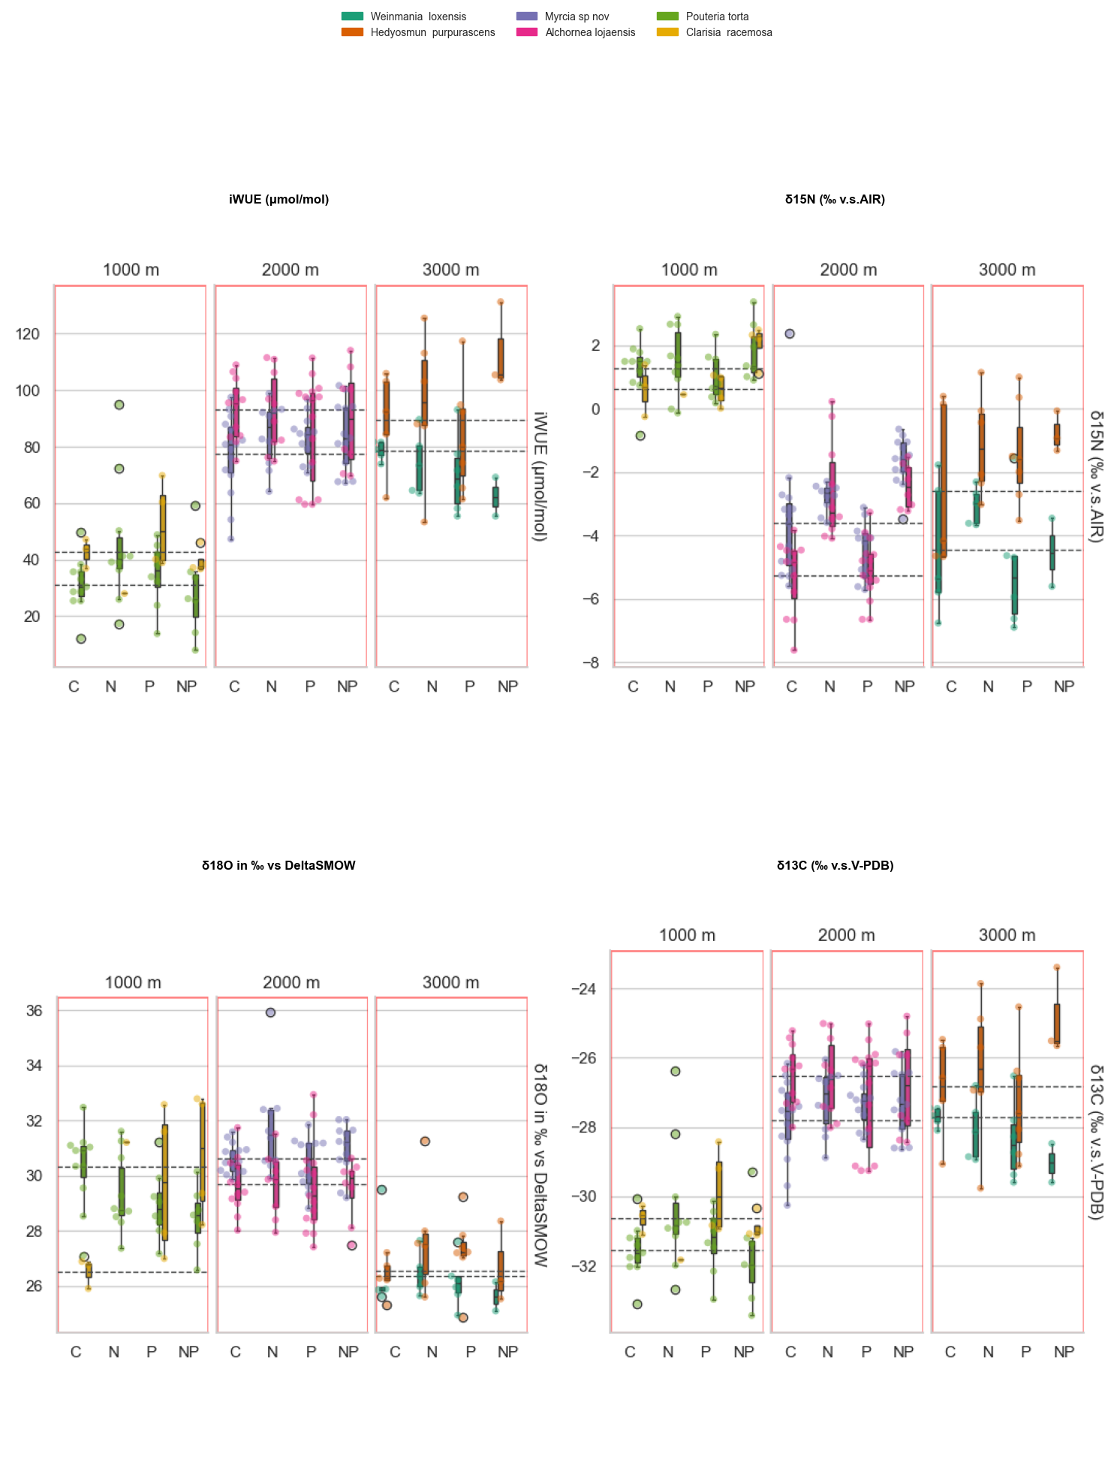
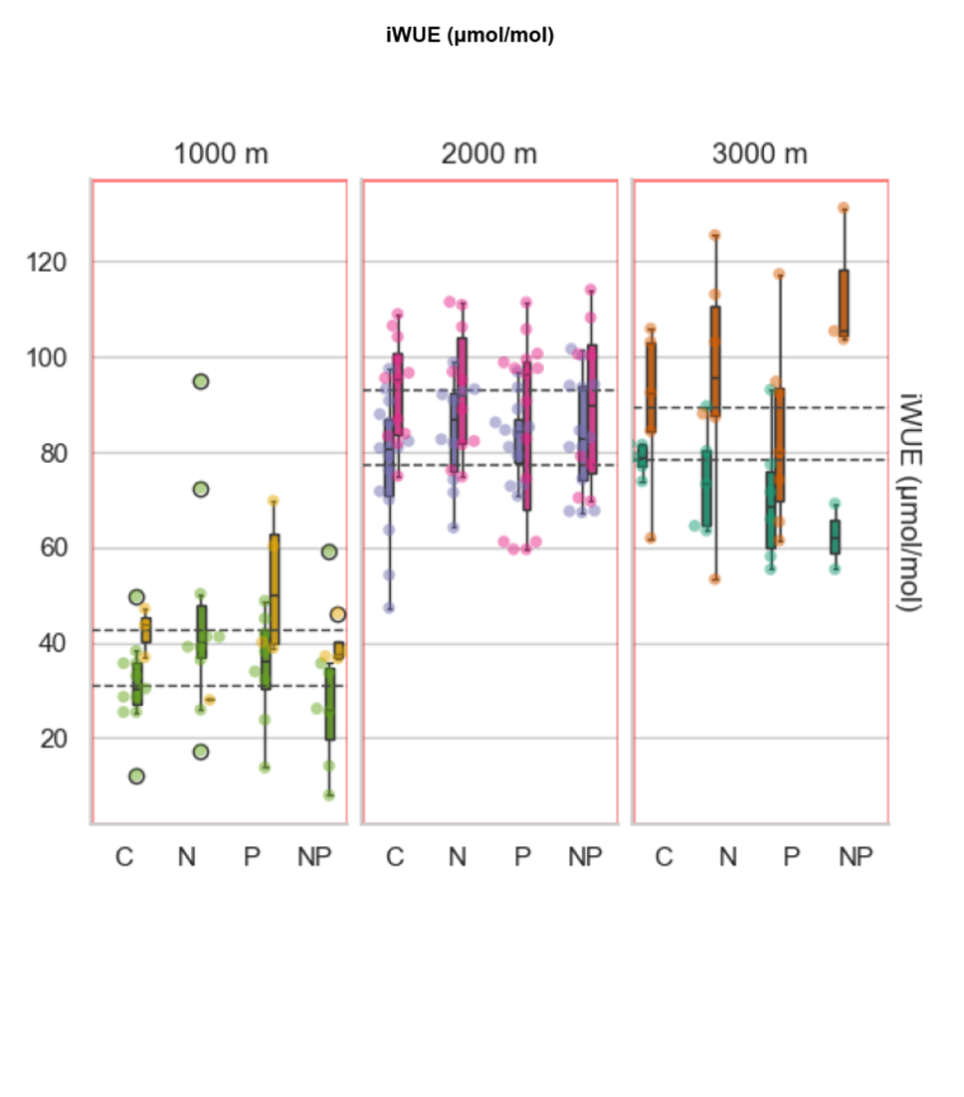
Notes:
U shaped.

Slide 13
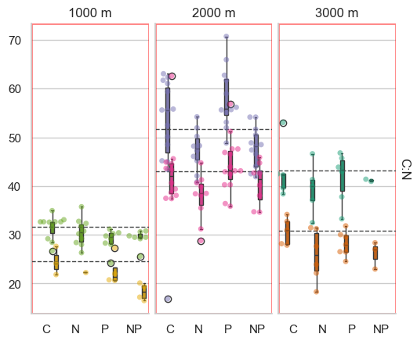
Notes:
Not sure how to model them.

Slide 14
Notes:
Con flecha errores

Slide 15
“COMPLETE” MODEL
lmer(Response variable~ N+P+N * P + elevation + (1 | specie)+ (1 | Block/Plot)).
For iWUE and d18O the model with elevation as a quadratic factor worked the best.
Nevertheless, for d15N I can not make it work. I think I am missing a biological interpreation, same for C:N
A I used DHARMa package for diagnosis.

Slide 16
MODEL FOR ALL ELEVATIONS
term | (Intercept) | (Intercept) | N | N | P | P | elevation_m | elevation_m | I(elevation_m^2) | I(elevation_m^2) | N × P | N × P | SD (Intercept Plot) | SD (Intercept name) | SD (elevation_m name) | Cor (Intercept~elevation_m name) | SD (Observations) | Num.Obs. | AIC
statistic | estimate | std.error | estimate | std.error | estimate | std.error | estimate | std.error | estimate | std.error | estimate | std.error | estimate | estimate | estimate | estimate | estimate
qiWUE | -49.467+ | -27.965 | 1.095 | -3.645 | -3.476 | -3.419 | 0.115*** | -0.031 | -0.000** | 0 | -1.373 | -5.436 | 5.626 | 8.57 |  |  | 14.013 | 182 | 1533.6
qO18 | 23.813*** | -1.982 | 0.39 | -0.311 | -0.095 | -0.294 | 0.008*** | -0.002 | -0.000*** | 0 | -0.356 | -0.456 | 0.253 | 0.58 |  |  | 1.369 | 180 | 695.6
N15 | 1.859 | -2.105 | 1.002** | -0.323 | -0.315 | -0.302 | -0.002* | -0.001 |  |  | 0.807+ | -0.481 | 0.51 | 1.918 |  |  | 1.232 | 182 | 657.8
CN | 28.466* | -12.528 | -3.314* | -1.314 | 0.649 | -1.241 | 0.004 | -0.006 |  |  | -1.205 | -1.945 | 1.56 | 11.505 |  |  | 5.408 | 182 | 1177.8
CN3 | 35.104*** | -4.46 | -3.628** | -1.176 | 0.935 | -1.114 |  |  |  |  | -0.899 | -1.705 | 0.215
I need help here, for the N15 and CN models.

Slide 17
DUAL ISOTOPE C AND O
Visual inspection shows clear patterns between the groups according to the elevations.
I created the plots per specie aiming to see clear differences between the treatments. Interesting to check Pouteria, Alchornea, Myrcia, Hedyosmum.
Still need to figure it more how to interpret it.

Slide 18
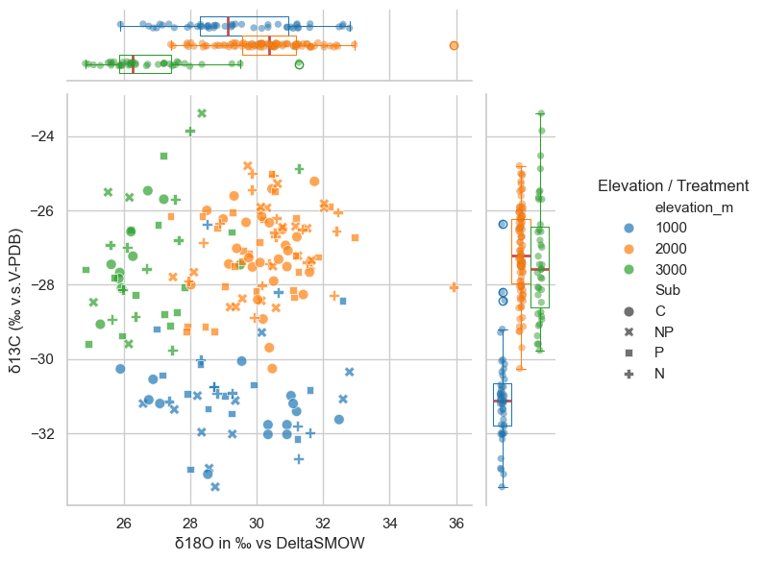
Notes:
Clear differences between elevations. Higher O18 enrichment in the lowlands and at 2000 m – associated with higher transpiration.

Slide 19
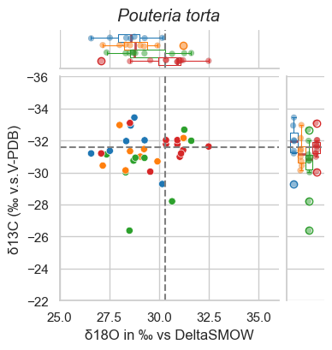
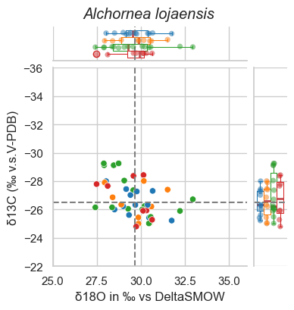
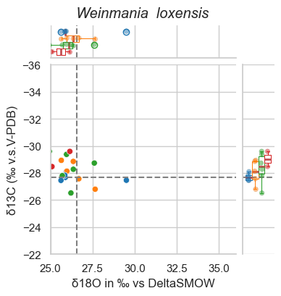
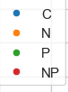
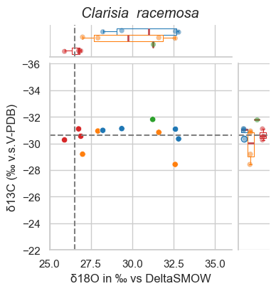
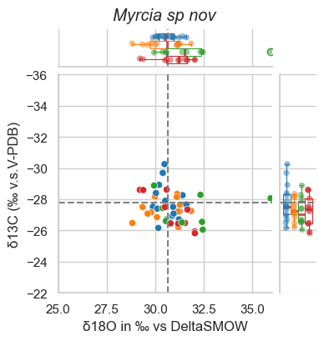
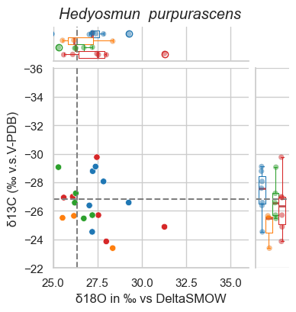
Notes:
Effects of treatment in Pouteria, Alchornea, Hedyosmum. Not sure if these graphics are actually useful. Dotted lines are the means of the control. Maybe I should plot the center instead?

Slide 20
NEXT STEPS AND QUESTIONS
I am currently exploring how to incorporate functional traits (SLA, wood density, leaf thickness and toughness), with the aim of using them to explain interspecific differences in physiological responses. I have started with species-level visualizations, but I am still refining their interpretation.
Once the trait-based framework is clearer, perhaps we can discuss, to extend the analyses to tree size variables (I have DBH and height on each individual and H seems to be interesting for iWUE). Potentially we could use growth, using the long-term monitoring data available since 2009. The experimental controls from 2009 (n = 9) would be used mainly as a baseline reference due to their limited sample size.
Regarding environmental drivers, elevation has been useful as an integrative gradient, but I would like to discuss the incorporation of explicit climatic variables to improve interpretability. I thought on working with PCA dimensions.
Additionally, I discussing about including a Topographic Position Index (TPI) to account for local-scale variation related to topography and microclimate.

